Slide 1


Slide 2
Major Project Review – I Contents
Abstract
Introduction
Literature Survey
Problem Statement in Existing System
Proposed System
Objectives
Project Domain
Requirement Analysis
  Functional Requirements
  Non-Functional Requirements
  Software Requirements
  Hardware Requirements
System Architecture
Methodology

Slide 3
Abstract
RoadGuard is an Al-based system designed to detect and assess road damage and help authorities plan road maintenance. It uses images or videos captured from mobile phones or vehicle-mounted cameras to identify road defects such as potholes, cracks, and surface damage using deep learning.
The system estimates the severity of each defect based on its type, size, and density. GPS is used to identify the damaged road location, road segment, and responsible authority. A priority score is then generated based on the severity of damage, road importance, location risk, and repeated reports.
The detected information is stored in a database and displayed through an inter active map and authority dashboard. RoadGuard supports both user complaints and automatic road inspections, helping to identify previously unreported damage. The system provides a data-driven approach to improve road monitoring, maintenance planning, and road safety.

Slide 4
Introduction
Transportation roadway networks deteriorate continuously due to heavy vehicular traffic loading, weathering, temperature variations, and material fatigue.
Common pavement distress categories include potholes, longitudinal cracks, transverse cracks, complex alligator/fatigue cracks, and surface ravelling.
Traditional manual road inspection relies on human visual surveys, which are inherently labor-intensive, slow, hazardous, and subject to observer bias.
Expanding municipal and highway networks demand scalable, continuous, and automated road condition monitoring solutions.
Computer vision and deep learning provide powerful opportunities to automate high-resolution pavement distress detection from optical imagery.
RoadGuard aims to advance beyond basic visual distress detection toward comprehensive damage severity evaluation, geospatial mapping, and automated maintenance prioritization.

Slide 5
Literature Survey
Table: Summary of representative pavement distress detection methods
Year | Author / Work | Approach | Contribution |  | Key Limitation
2018 | Traditional Vision | Canny edge detec-tion, Otsu thresh-olding | Handcrafted phological extraction | mor-crack | Highly sensitive to shadows, lighting,andtextures
2019
Zou et al. (DeepCrack)
Hierarchical deep
Multi-scale feature
High false posi-
CNN
fusion
Atrous Pyramid (ASPP)
multi-scale
integration for
tives on dark shad-ows and stains
Discontinuous
crack segmentation
2021
Chen et al. (DeepLabv3+)
Spatial Pooling
Captures multi-scale contextual semantic cues
boundaries on
thin, low-contrast cracks
Bounding boxes only; lacks severity & GIS mapping
2021
Arya et al. (GRDDC)
Multi-country deep object detection
Large national damage mark
multi-road bench-
2024
Zhang et al. (Base Paper)
DARNet: Xception
Distress-aware
+ CFASPP + attention
Standalone detec-tion; lacks sever-ity, GPS, & prior-ity
with
DAAM + REM
boundary ment
refine-

Slide 6
Literature Survey: Base Paper
Databases: IEEE Xplore, ScienceDirect, SpringerLink, Scopus, Web of Science, and ACM Digital Library
Keywords: “pavement distress detection”, “road damage segmentation”, “deep learning pavement inspection”, “pothole detection”, “crack segmentation CNN”, “explainable AI road damage”
Time Window: 2018 – 2024 (with specific emphasis on recent benchmark architectures)
Inclusion Criteria: Peer-reviewed journal and conference publications addressing automated visual pavement distress detection, segmentation models, or road inspection systems
Exclusion Criteria: Studies limited to non-vision sensors (e.g., purely accelerometer/vibration-based), non-peer-reviewed preprints, and non-English publications

Slide 7
Problem Statement in Existing System
Manual Inspection Limitations: Traditional monitoring depends on manual visual surveys and citizen complaints, which are labor-intensive, hazardous, and slow to mobilize.
Scalability Bottlenecks: Municipal and highway networks expand rapidly, making periodic human visual inspection impractical across vast road corridors.
Subjectivity & Inconsistency: Visual condition rating by human inspectors is subjective, resulting in inconsistent distress severity grading and repair delays.
Isolated Image-Based Models: Existing deep-learning systems output only raw bounding boxes or masks without quantifying physical severity or cluster density.
Lack of Integrated Maintenance Prioritization: Detections are rarely linked to GPS coordinates, road importance, administrative jurisdictions, or repair triage.
ROADGUARD / TEAM
September 2026 7 / 18

Slide 8
Proposed System: RoadGuard
Road Image / Video Input
Road Damage Detection
Severity Assessment
Location / GPS Extraction
XAI & Authority Dashboard
Maintenance Prioritization
Jurisdiction Assignment
Road Segment Identification
End-to-End Automation: Seamless pipeline connecting optical road imagery directly to municipal maintenance work orders.
Multi-Class Defect Detection: Accurately localizes potholes, longitudinal cracks, transverse cracks, and alligator cracks.
Objective Severity Scoring: Evaluates damage dimensions, surface coverage, and localized defect density.
Geospatial Asset Linking: Maps GPS coordinates to road segments, functional road categories, and responsible departments.
Explainable Prioritization: Delivers transparent visual heatmaps and ranked maintenance schedules on an interactive dashboard.

Slide 9
Objectives
O1: Develop a deep learning-based model to automatically detect and classify pavement distress from road imagery.
O2: Identify multiple defect categories including potholes, longitudinal cracks, transverse cracks, and alligator cracks.
O3: Formulate an objective damage severity assessment model based on defect type, physical size, and local density.
O4: Integrate GPS coordinate extraction to localize detected damage instances accurately along surveyed road corridors.
O5: Implement an automated road-segment and jurisdiction mapping module to identify responsible maintenance departments.
O6: Develop an intelligent maintenance priority model balancing damage severity, defect concentration, road type, and risk.
O7: Provide explainable AI visualizations and an interactive GIS dashboardfor transparent maintenance decision-making.

Slide 10
Project Domain
Technical Focus Areas:
Deep Learning: Convolutional neural networks and attention architectures for robust spatial feature representation.
Computer Vision: Automated object detection, distress localization, and defect boundary segmentation.
Digital Image Processing: Illumination correction, adaptive histogram equalization, and morphological edge analysis.
Geospatial Analysis & GIS: GPS telemetry extraction, spatial indexing, road-segment matching, and boundary attribution.
Explainable AI (XAI): Visual attention heatmaps and transparent feature attribution for verifiable engineering decisions.
Intelligent Infrastructure Monitoring: Data-driven road condition assessment, risk modeling, and predictive repair triage.

Slide 11
Requirement Analysis: Functional Requirements
FR1 – Image & Video Input: Ingest optical road imagery and video streams from vehicle cameras and mobile survey units.
FR2 – Image Preprocessing: Perform automated noise suppression, illumination normalization, and image enhancement.
FR3 – Damage Detection: Detect and classify potholes, longitudinal cracks, transverse cracks, and alligator cracks.
FR4 – Severity Assessment: Quantify defect severity levels based on bounding dimensions, surface area, and cluster density.
FR5 – Location Association: Extract and associate spatial latitude and longitude coordinates with detected defects.
FR6 – Road Segment Identification: Match GPS coordinates to specific road corridors and functional road hierarchies.
FR7 – Jurisdiction Mapping: Route identified distress points to the responsible administrative authority (e.g., Municipality, PWD, NHAI).
FR8 – Maintenance Prioritization: Compute multi-factor maintenance priority scores based on damage, road type, and risk.

Slide 12
Requirement Analysis: Non-Functional Requirements
NFR1 – Accuracy: Achieve high precision, recall, and mAP in identifying diverse distress types across varied road surfaces.
NFR2 – Reliability: Ensure consistent defect detection under challenging lighting, heavy shadows, and weathered textures.
NFR3 – Performance: Deliver low-latency image inference suitable for rapid batch processing and mobile survey units.
NFR4 – Scalability: Support expanding road networks, high volumes of survey frames, and multi-agency user access.
NFR5 – Usability: Provide an intuitive, interactive dashboard interface for municipal engineers with minimal technical overhead.
NFR6 – Security: Ensure secure storage, integrity of geotagged survey reports, and role-based access for authorities.
NFR7 – Maintainability: Maintain a loosely coupled modular architecture allowing independent model updates and dataset retraining.

Slide 13
Requirement Analysis: Software & Hardware Requirements
Software Requirements
Operating System: Windows 10 / 11, Linux (Ubuntu)
Programming Language: Python 3.10+
Deep Learning Frameworks: PyTorch, Torchvision, Ultralytics YOLO
Computer Vision: OpenCV, Pillow, NumPy
Geospatial & GIS Tools: GeoPandas, Shapely, Folium / Leaflet
Database Management: PostgreSQL with PostGIS / SQLite
Hardware Requirements
Processor (CPU): Intel Core i5 / i7 (8th Gen+) or AMD Ryzen 5 / 7
Graphics Card (GPU): NVIDIA GeForce GTX 1650 / RTX 3060 (4GB+ VRAM) with CUDA support
System Memory (RAM): 16 GB DDR4 RAM
Storage: 512 GB NVMe SSD (fast dataset and model weight I/O)
Capture Devices: High-resolution mobile camera (12MP+) / Vehicle-mounted
ptember 2026 13 / 18

Slide 14
System Architecture
Road Images / Videos & GPS Telemetry
Deep Learning Damage Detection
GPS Localization & Road Segmenting
Intelligent Maintenance Prioritization
Image Preprocessing & Normalization
Severity Assessment (Size, Type, Density)
Jurisdiction & Agency Assignment
Explainable AI & Interactive Dashboard
Input Tier: Ingests optical roadway frames and GPS coordinate metadata.
Vision Tier: Performs defect detection and quantitative physical severity scoring.
Spatial Tier: Associates defects with road segments and responsible authorities.
Decision Tier: Ranks maintenance urgency and visualizes data on an interactive GIS console.

Slide 15
System Architecture: Components
Data Acquisition & Ingestion Module: Captures and ingests road imagery and video frames from mobile survey units, vehicular dashcams, and citizen reports.
Image Preprocessing Module: Performs noise reduction, illumination correction, and adaptive contrast enhancement to standardize raw visual inputs.
Deep Learning Detection Module: Utilizes deep convolutional feature extractors to detect, classify, and localize diverse road distress categories.
Severity Assessment Module: Evaluates damage dimensions, defect density, and surface coverage to assign objective severity levels.
Geospatial & Road-Segment Module: Extracts GPS metadata to accurately match distress instances with municipal road corridors and road classifications.
Jurisdiction Assignment Module: Automatically routes verified defects to the responsible agency (e.g., Municipality, PWD, NHAI) based on spatial boundaries.
Maintenance Prioritization Engine: Ranks repair urgency using a

Slide 16
Methodology
Stage 1 – Data Collection: Gather diverse pavement imagery from public benchmarks (RDD2022, Crack500) and localized mobile survey captures.
Stage 2 – Data Preprocessing: Normalize contrast, resize frames, apply illumination equalization, and generate data augmentations.
Stage 3 – Road Damage Detection: Extract multiscale visual features using deep convolutional layers to locate pavement distress areas.
Stage 4 – Damage Classification: Categorize detected distress into potholes, longitudinal cracks, transverse cracks, and alligator cracks.
Stage 5 – Severity Assessment: Quantify physical distress severity levels using bounding dimensions, segmented area, and defect concentration.
Stage 6 – Location Association: Extract GNSS/GPS coordinate metadata to determine exact spatial locations of defects.
Stage 7 – Road Segment Mapping: Align defect coordinates with municipal GIS road layers to identify road types and responsible authorities.
Stage 8 – Maintenance Prioritization: Calculate an objective repair priority score combining severity, traffic importance, and structural risk.
Stage 9 – Explainable AI: Produce saliency/attention maps to provide
18

Slide 17
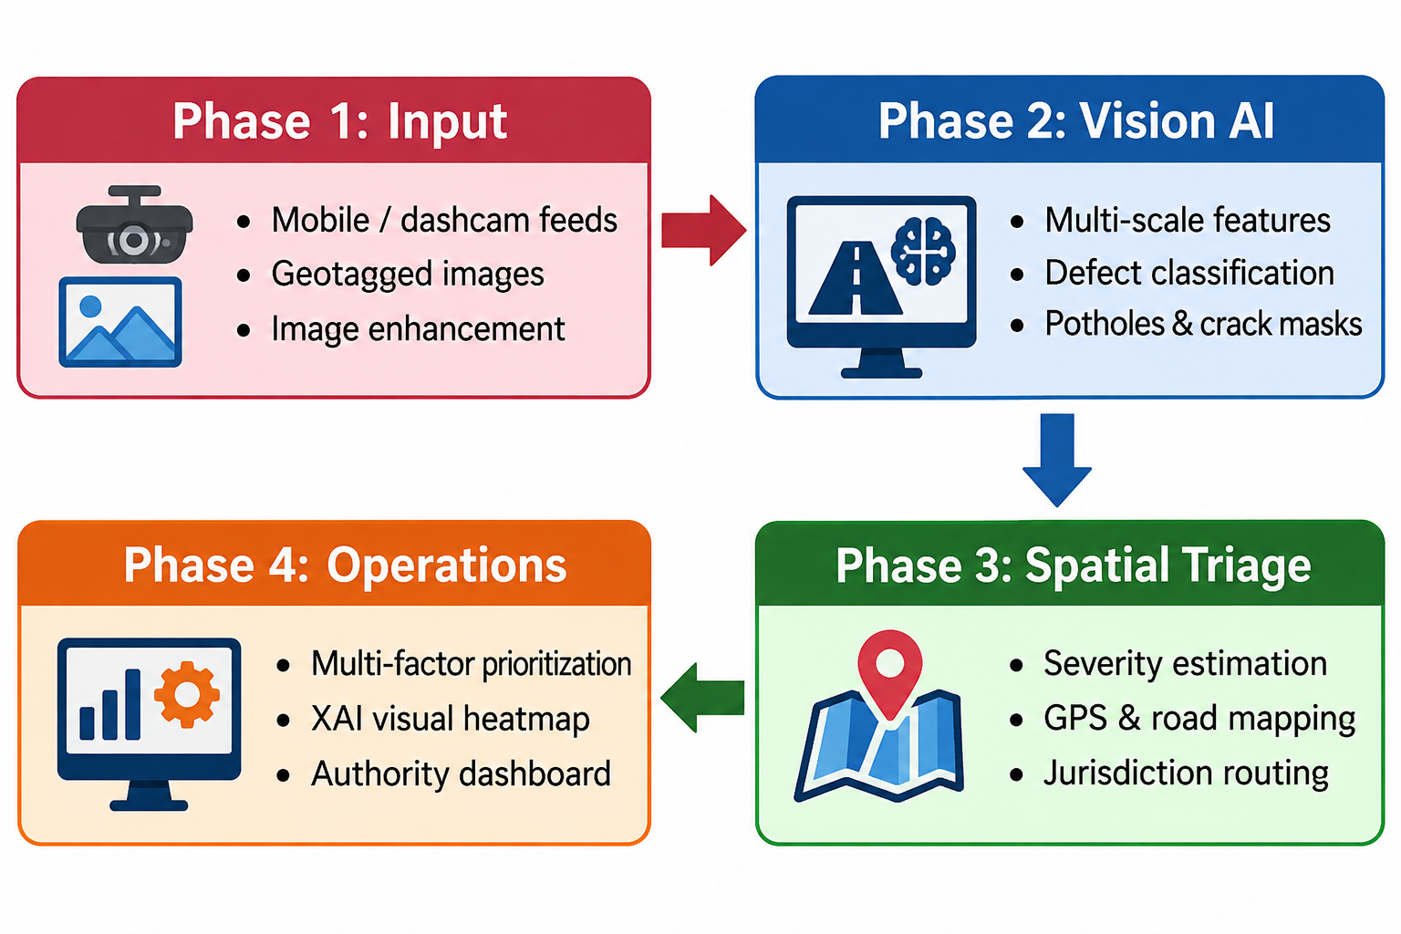
Methodology: Detailed Workflow

Slide 18
Methodology: Detailed Workflow
Step 1 (Sensing & Ingestion): Captures continuous video or citizen photos and extracts synchronized geospatial coordinates.
Step 2 (Visual Feature Analysis): Applies deep convolutional backbones to detect distress boundaries and classify morphological types.
Step 3 (Geospatial & Risk Attribution): Quantifies physical defect severity and matches damage instances to administrative road assets.
Step 4 (Actionable Maintenance Triage): Computes repair priority rankings and publishes explainable evidence for engineering action.

Slide 19
Thank You
Questions & Discussion
Student Team:
Ch Satyanarayana G S S Priya A J S Prasanna G Nikhil
Project Guide:
Mrs. G Venkata Lakshmi
Department of Artificial Intelligence & Machine Learning Sri Vasavi Engineering College (Autonomous) Pedatadepalli, Tadepalligudem, Andhra Pradesh, India

